Slide 1

For Our Red King
high-level language programming project
XXX 汇报人

Slide 2


Contents
01. Key issues for System
02. General and Detailed Design
03. Our Harvest
04. Programming Progress

Slide 3

Key issues for System

Slide 4







1. Building Battle Scenes and Configuring Levels
2. Create Initial Interface, Include
-ing Settings, Start Game, Save, etc
3. Instantiate the Main Character
and Enemies,
Implement Attack, Positioning, Move-ment, and Survi
-val Judgement
4. Implement Cha
-racter and Map
Interaction, Such as Jumping, Climbing, Opening Doors, etc
5. Timely Valida-
tion of Player Input
6. Screen Update
7. Quick Time Event (QTE)

Slide 5
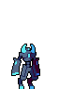
General and Detailed Design

Slide 6
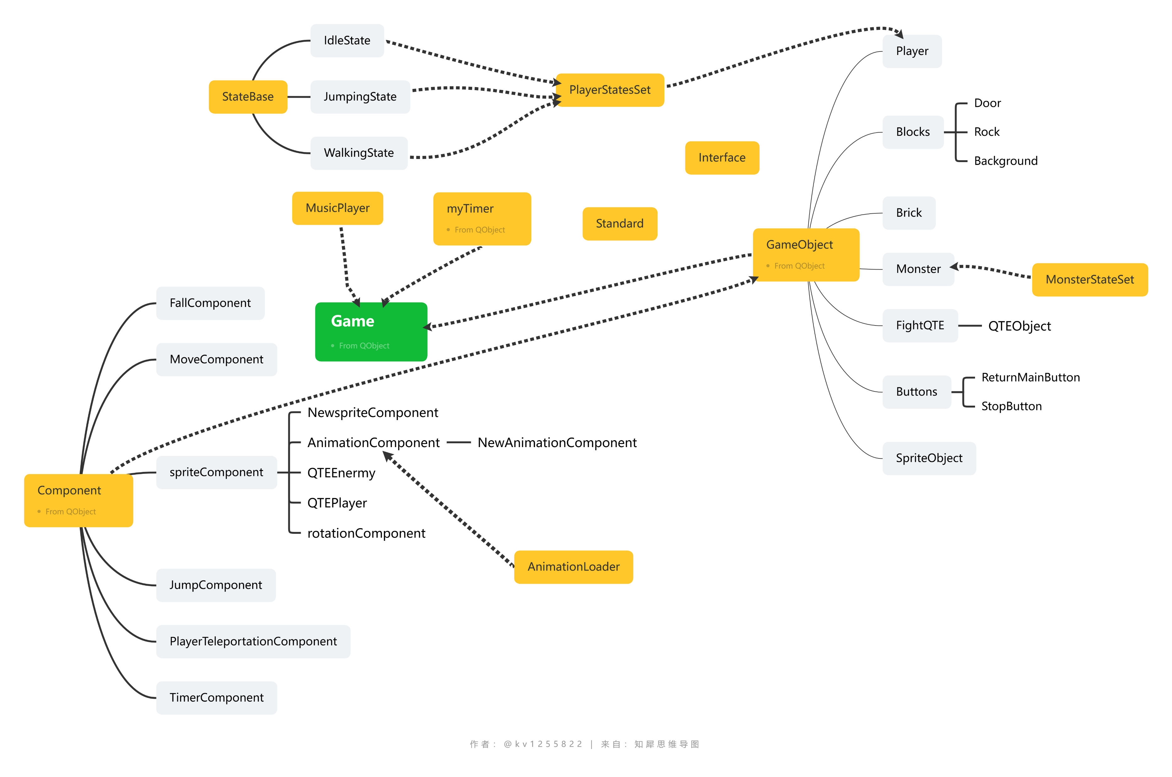
Total classes

Slide 7
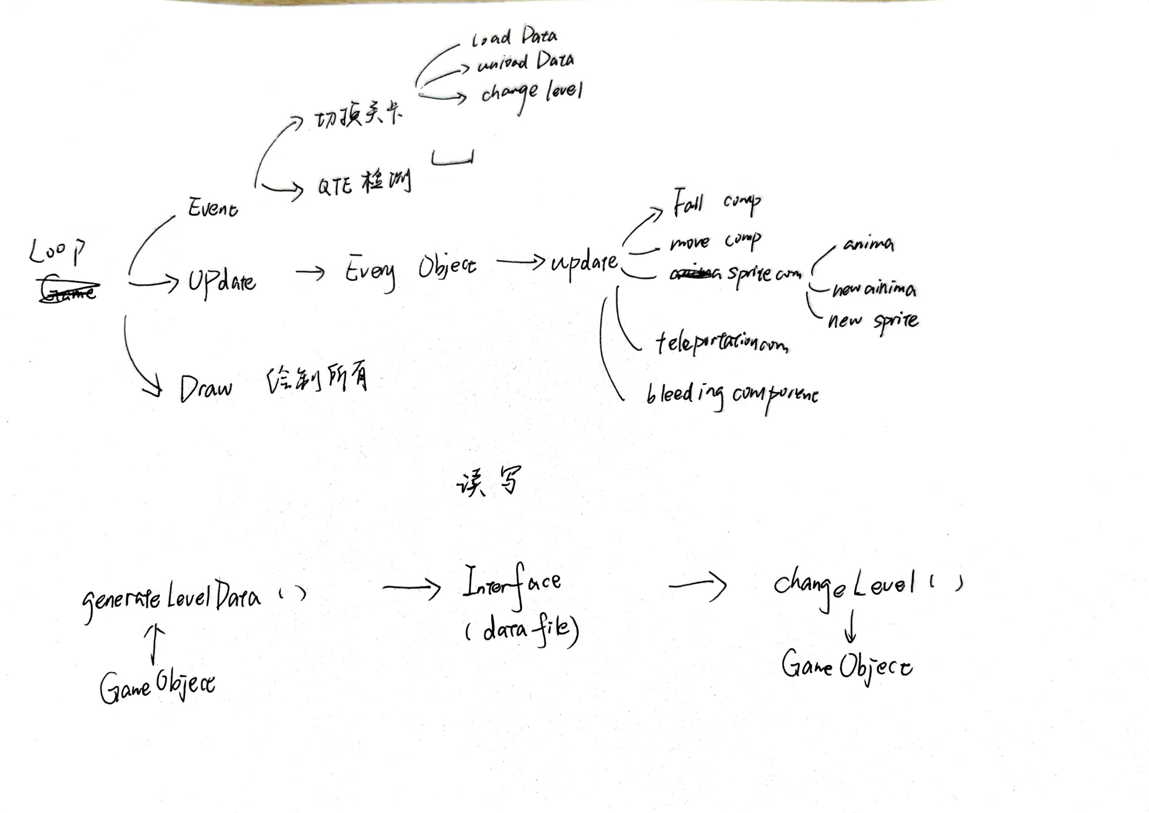
1. The overall framework and main loop

Slide 8
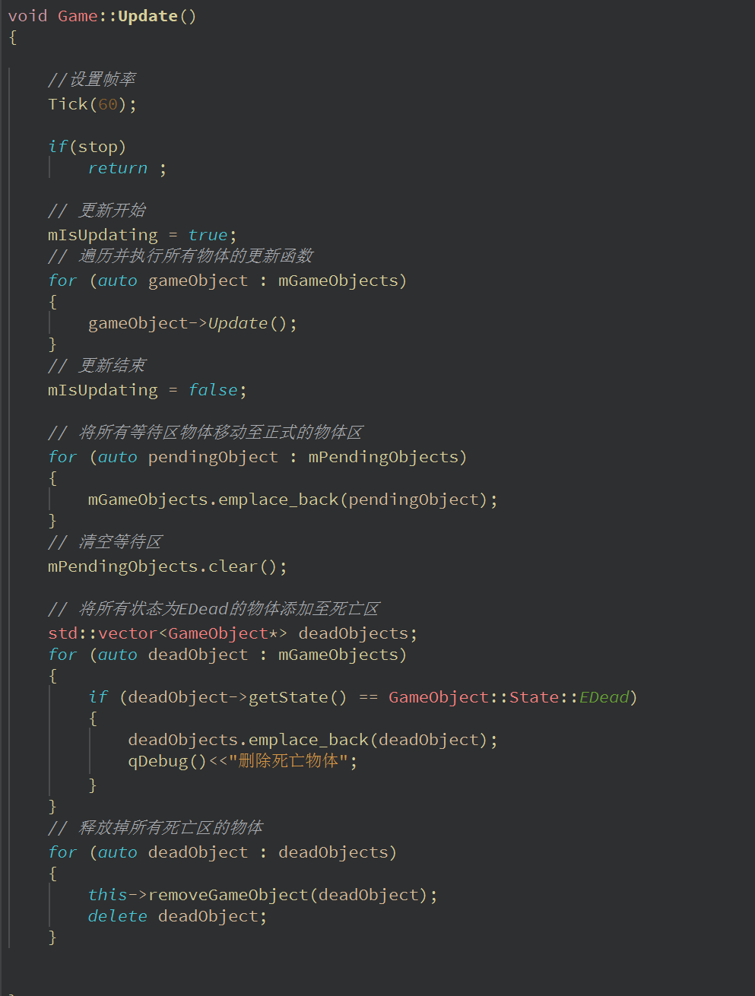
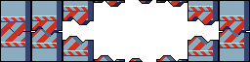
Key part:
Update( ) function

Slide 9
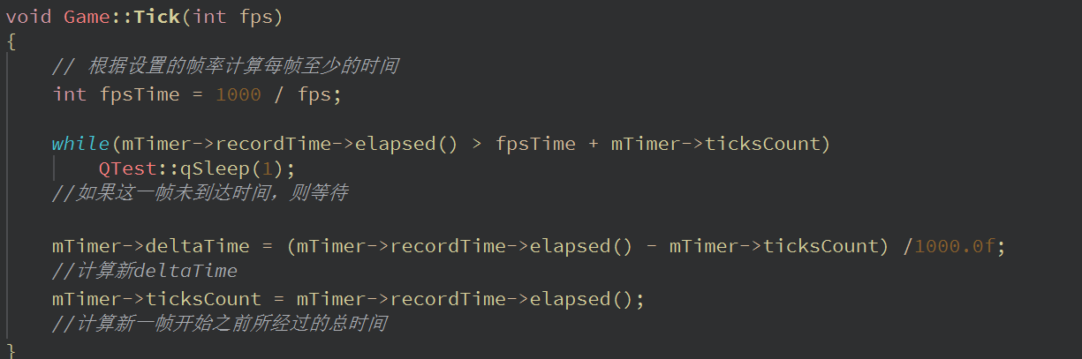
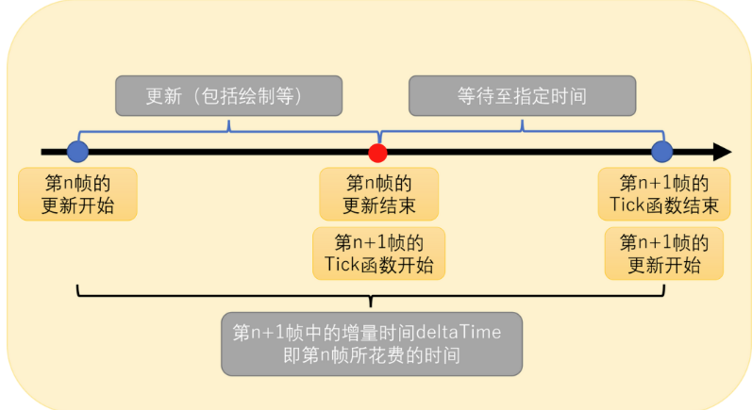
“Waiting is the most romantic confession.”

Slide 10
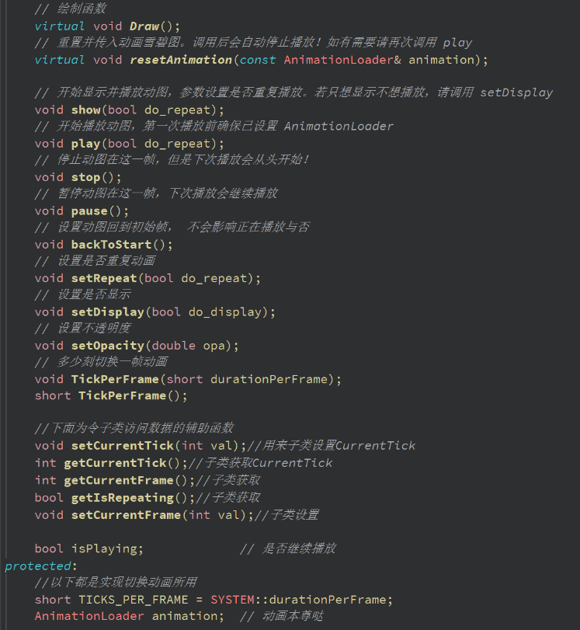

AnimationComponent
2.AnimationComponent
AnimationLoader
Standard
“The three categories work together to provide great support for later maintenance.”
A
Animation Component

Slide 11
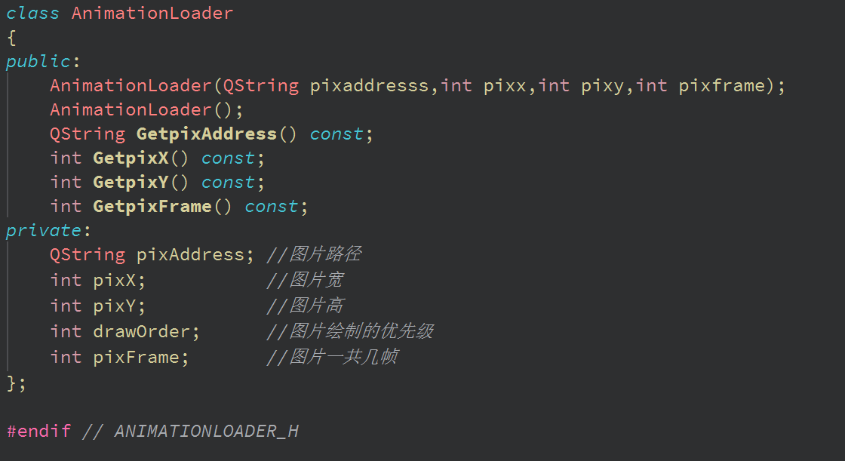
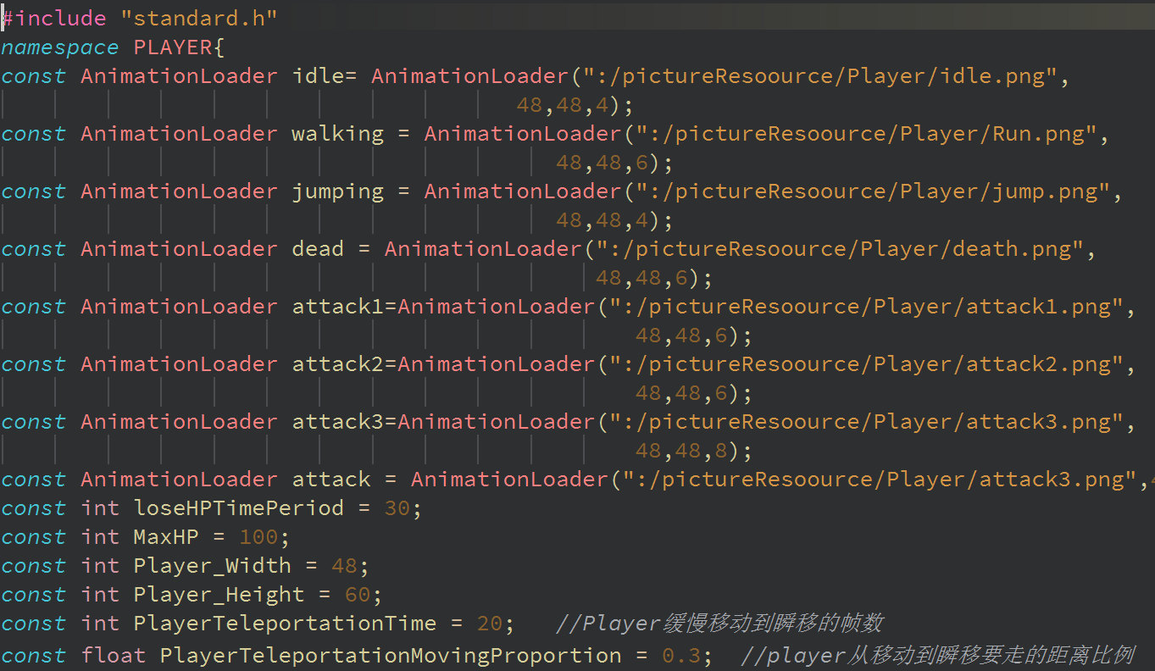
B
Animation Loader
C
Standard

Slide 12
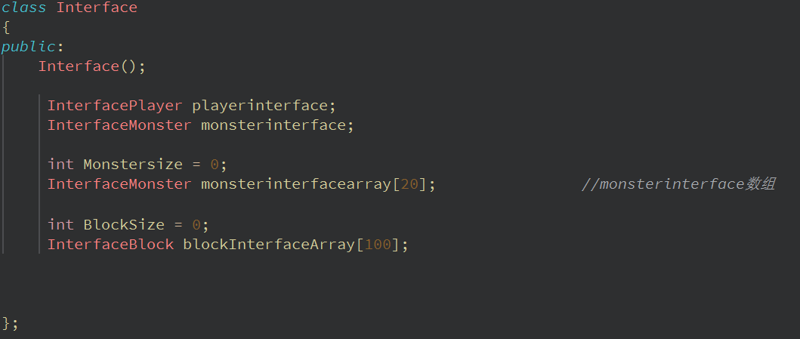
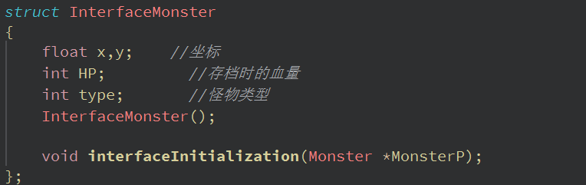
3.How to create a level ?
By Class Interface

Slide 13
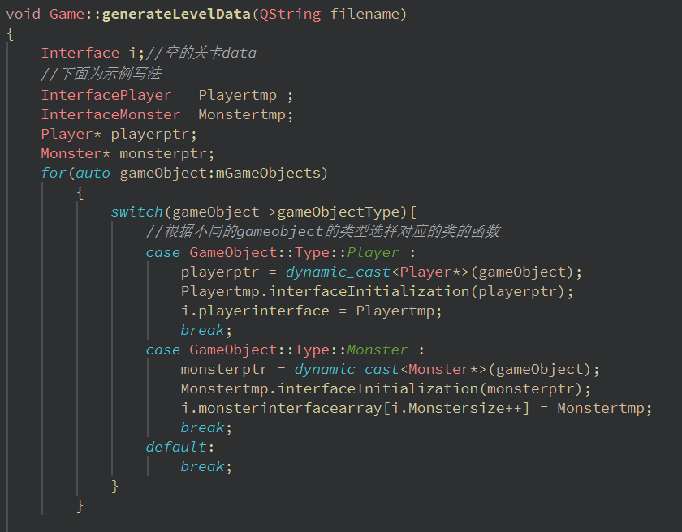
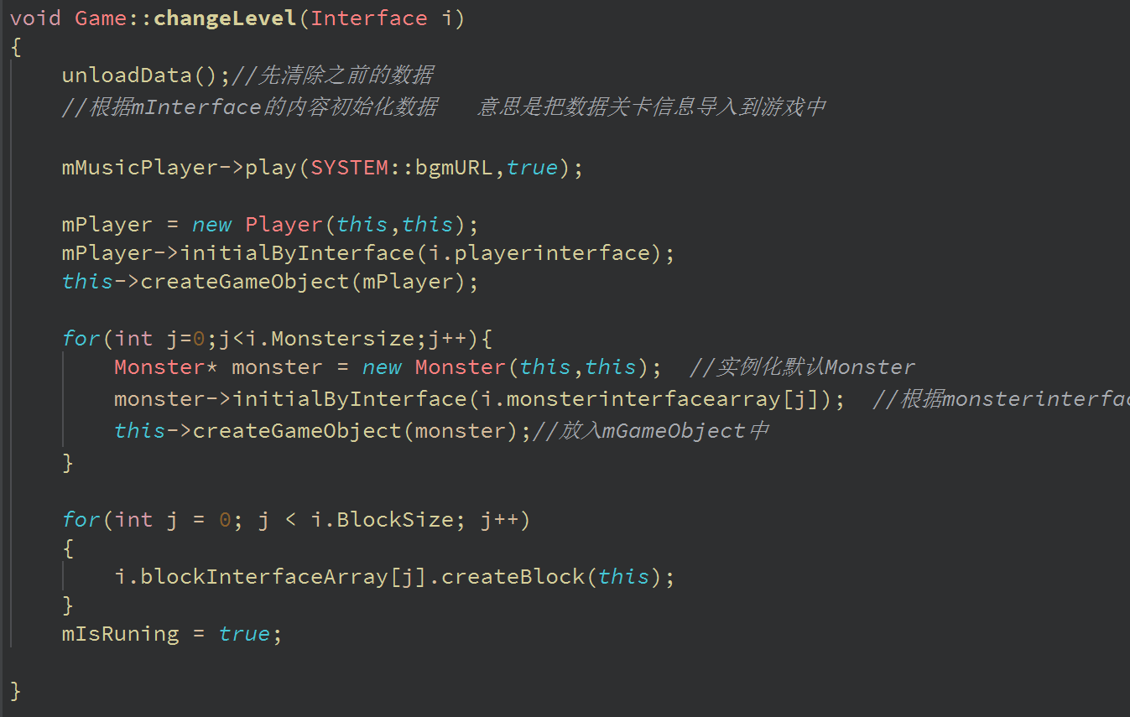
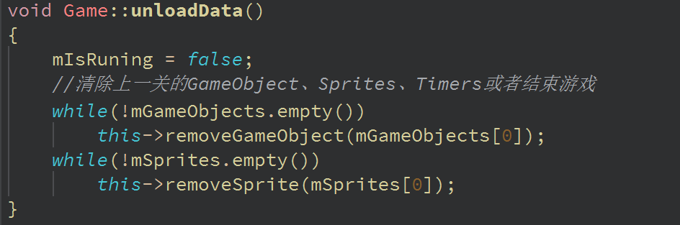
Generate level data
Change level

Slide 14
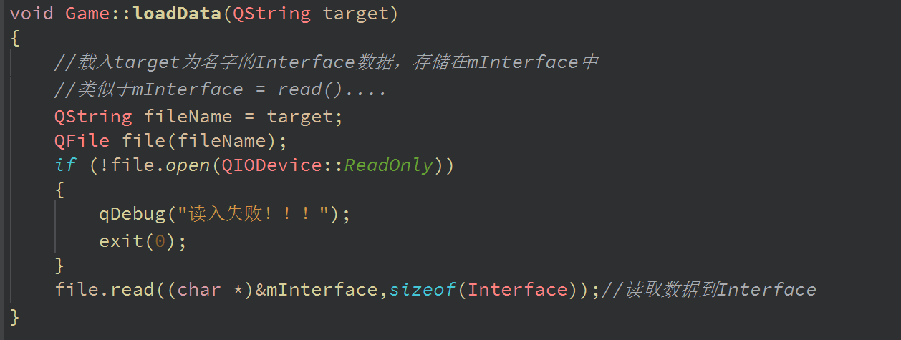
Load data

Slide 15
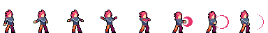
4.Quick Time Event
(QTE)
Understand more clearly
through taking part of the game

Slide 16
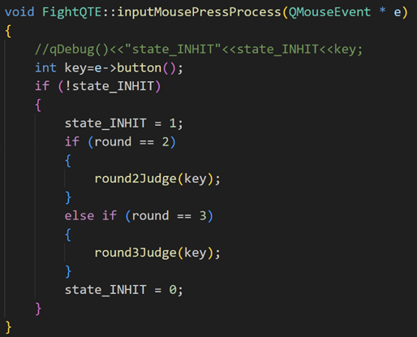
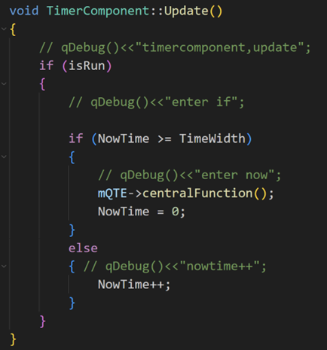
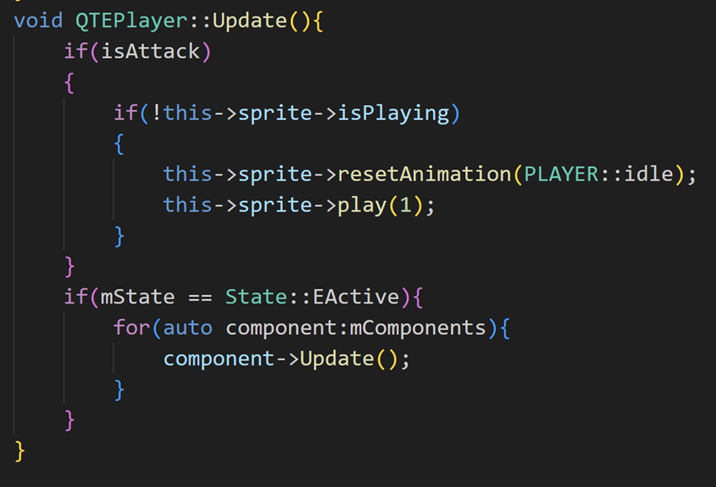

Slide 17

Our Harvest

Slide 18
Concise and Powerful Annotations
Communication
Huge
Harvest
QT
Game
Framework
Cooperation
Animation Processing
The Charm
of Classes

Slide 19
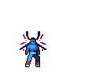
Programming Progress

Slide 20

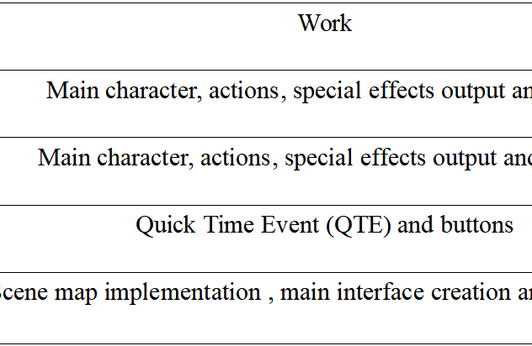
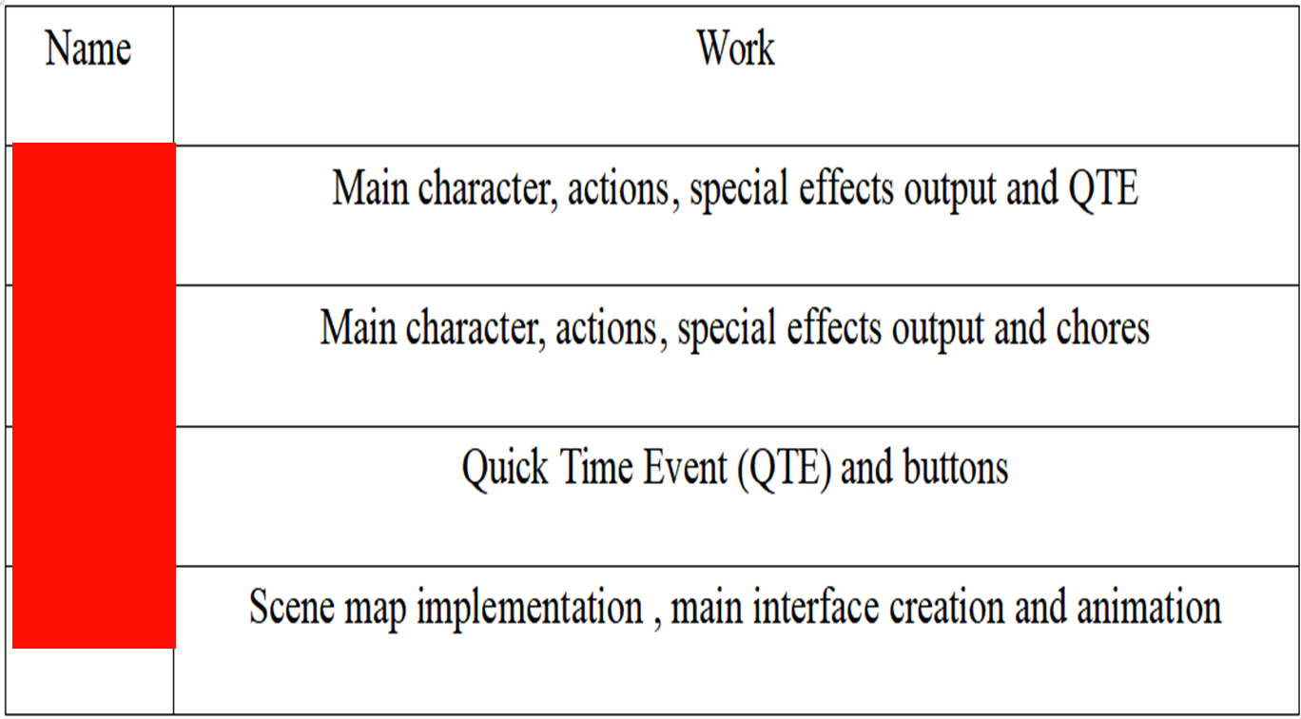
Integration work
done by all
team members:
1.Different
components
and
gameobjects calling or combining with
each other.
2.Construction of
the main loop.

Slide 21
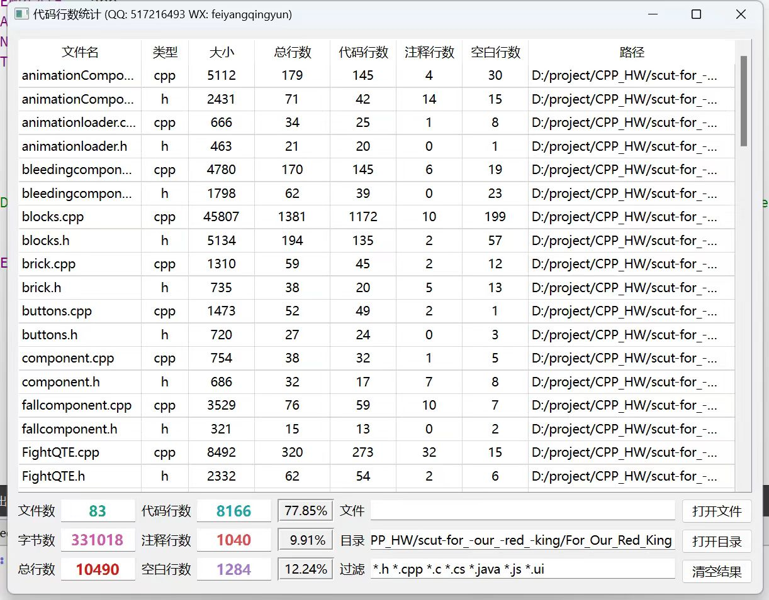

Code statistics

Slide 22
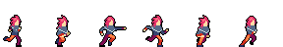
Thanks !

